Slide 1
Lecture- 3 Types of Personalities

Slide 2
What is Personality?
Personality is defined as the characteristic sets of behaviors, cognitions, and emotional patterns that evolve from biological and environmental factors.
It is the combination of characteristics or qualities that form an individual's distinctive character.
Also defined as individual differences in characteristic patterns of thinking, feeling and behaving.

Slide 3
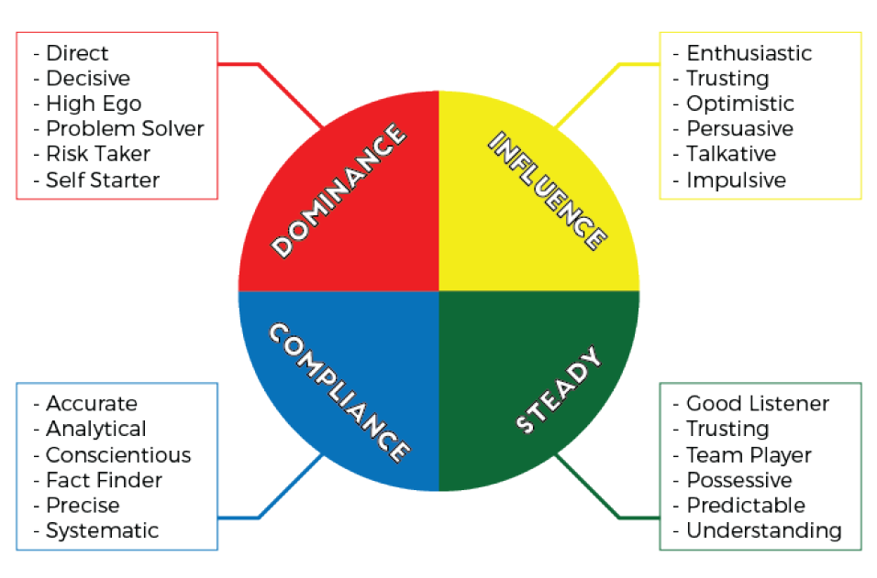
Types of personalities

Slide 4
About DISC profiles
The 4 different types of personalities are a basic division of 4 different behavior sets
Each person is a combination of two or more behavior sets
No one falls purely into one category
Each person has a primary personality and secondary personality
Combination of both makes the person complete behavior set being called “the attitude”

Slide 5
Articles to read:
https://www.verywellmind.com/what-is-personality-2795416
https://www.today.com/health/personality-types-average-self-centered-role-model-or-reserved-t137902

